Slide 1
ExceptionHandling
Module4

Slide 2
Exception Handling
An exception is an abnormal condition that arises in a code sequence at run time. In other words, an exception is a run-time error. In computer languages that do not support exception handling, errors must be checked and handled manually-typically through the use of error codes. This approach is as cumbersome as it is troublesome. Java's exception handling avoids these problems and, in the process, brings run-time error management into the object oriented world.

Slide 3
Reasons to handle exceptions
Invalid user input
Device failure
Loss of network connection
Physical limitations (out-of-disk memory)
Code errors
Opening an unavailable file
Errors represent irrecoverable conditions such as Java virtual machine (JVM)
running out of memory,
memory leaks,
stack overflow errors,
library incompatibility,
infinite recursion, etc.
Errors are usually beyond the control of the programmer, and we should not try to handle errors.

Slide 4
Exception Handling Fundamentals
A Java exception is an object that describes an exceptional (that is, error) condition that has occurred in a piece of code. When an exceptional condition arises, an object representing that exception is created and thrown in the method that caused the error. That method may choose to handle the exception itself, or pass it on. Either way, at some point, the exception is caught and processed.

Slide 5
Exceptions can be generated by the Java run-time system, or they can be manually generated by your code. Exceptions thrown by Java relate to fundamental errors that violate the rules of the Java language or the constraints of the Java execution environment. Manually generated exceptions are typically used to report some error condition to the caller of a method.

Slide 6
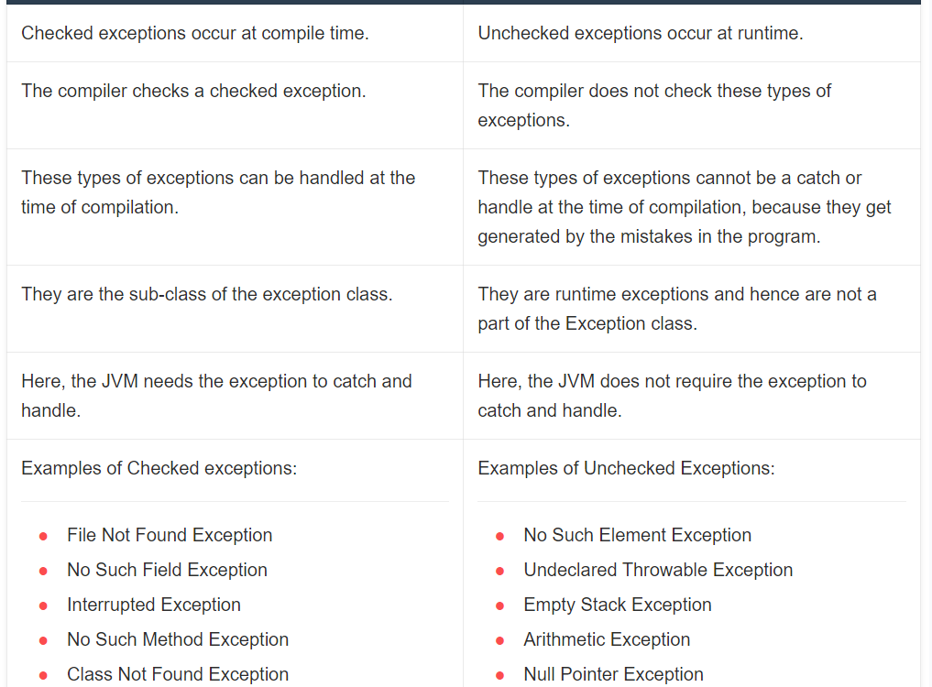

Slide 7
Java exception handling is managed using five keywords:
try: A suspected code segment is kept inside try block.
catch: The remedy is written within catch block.
throw: Whenever run-time error occurs, the code must throw an exception.
throws: If a method cannot handle any exception by its own and some subsequent methods needs to handle them, then a method can be specified with throws keyword with its declaration.
finally: block should contain the code to be executed after finishing try-block.

Slide 8
The general form of exception handling is try
try
{
// block of code to monitor errors
}
catch (ExceptionType1 exOb)
{
// exception handler for Exception Type1
}
catch (ExceptionType2 exOb)
{
// exception handler for Exception Type2
}
…..
finally
{
// block of code to be executed after try block ends
}

Slide 9
Exception Types
All the exceptions are the derived classes of built- in class viz. Throwable.
It has two subclasses viz.
Exception and Error

Slide 10
Exception class is used for exceptional conditions that user programs should catch. We can inherit from this class to create our own custom exception types. There is an important subclass of Exception, called RuntimeException. Exceptions of this type are automatically defined for the programs that you write and include things such as division by zero and invalid array indexing.

Slide 11
Error class defines exceptions that are not expected to be caught under normal circumstances by our program. Exceptions of type Error are used by the Java run-time system to indicate errors having to do with the run-time environment, itself. Stack overflow is an example of such an error.

Slide 12
Uncaught Exceptions
Let us see, what happens if we do not handle exceptions.
class Exco
{
public static void main(String args[])
{
int d = 0;
int a = 42/d;
}
}

Slide 13
When the Java run-time system detects the attempt to divide by zero, it constructs a new exception object and then throws this exception. This causes the execution of Exc0 to stop, because once an exception has been thrown, it must be caught by an exception handler and dealt with immediately. Since, in the above program, we have not supplied any exception handlers of our own, so the exception is caught by the default handler provided by the Java run-time system.

Slide 14
Any un-caught exception is handled by default handler. The default handler displays a string describing the exception, prints a stack trace from the point at which the exception occurred, and terminates the program. Here is the exception generated when above example is executed:
java.lang.ArithmeticException: / by zero
at Exc0.main(Exc0.java:6)

Slide 15
The stack trace displays class name, method name, file name and line number causing the exception. Also, the type of exception thrown viz.
ArithmeticException which is the subclass of Exception is displayed. The type of exception gives more information about what type of error has occurred. The stack trace will always show the sequence of method invocations that led up to the error.

Slide 16
Class Exc1
{
static void subroutine()
{
int d = 0;
int a = 10/d;
}
public static void main(String args[])
{
Exc1.subroutine();
}
}

Slide 17
The resulting stack trace from the default exception handler shows how the entire call stack is displayed:
java.lang.ArithmeticException: / by zero
at Exc1.subroutine (Exc1.java:6)
at Exc1.main(Exc1.java:10)
Using try and catch
Handling the exception by our own is very much essential as
We can display appropriate error message instead of allowing Java run-time to display stack- trace.
It prevents the program from automatic (or abnormal) termination.

Slide 18
To handle run-time error, we need to enclose the suspected code within try block.
class Exc2
{
public static void main(String args[])
{ int d, a;
try
{
d=0;
a = 42/d;
System.out.println("This will not be printed.“);
}
catch (ArithmeticException e)
{
System.out.println("Division by zero.");
System.out.println("After catch statement");
}
Output:
Division by zero.
After catch statement.

Slide 19
The goal of most well-constructed catch clauses should be to resolve the exceptional condition and then continue on as if the error had never happened.

Slide 20
The output of above program is not predictable exactly, as we are generating random numbers. But, the loop will execute 10 times. In each iteration, two random numbers (b and c) will be generated. When their division results in zero, then exception will be caught. Even after exception, loop will continue to execute.

Slide 21
Displaying a Description of an Exception
We can display this description in a println() statement by simply passing the exception as an argument.
This is possible because Throwable overrides the toString() method (defined by Object) so that it returns a string containing a description of the exception.
catch (ArithmeticException e)
{
System.out.println("Exception: " + e);
a = 0;
}
Now, whenever exception occurs, the output will be Exception java lang ArithmeticException. /by zero.

Slide 22
Multiple Catch Clause
In some cases, more than one exception could be raised by a single piece of code. To handle this type of situation, you can specify two or more catch clauses, each catching a different type of exception. When an exception is thrown, each catch statement is inspected in order, and the first one whose type matches that of the exception is executed. After one catch statement executes, the others are bypassed, and execution continues after the try/catch block.

Slide 23
While using multiple catch blocks, we should give the exception types in a hierarchy of subclass to superclass. Because, catch statement that uses a superclass will catch all exceptions of its own type plus all that of its subclasses. Hence, the subclass exception given after superclass exception is never caught and is a unreachable code, that is an error in Java

Slide 24
Nested try Statements
The try statement can be nested. That is, a try statement can be inside the block of another try. Each time a try statement is entered, the context of that exception is pushed on the stack. If an inner try statement does not have a catch handler for a particular exception, the stack is unwound and the next try statement's catch handlers are inspected for a match. This continues until one of the catch statements succeeds, or until all the nested try statements are exhausted. If no catch statement matches, then the Java run-time system will handle the exception.

Slide 25
throw
Till now, we have seen catching the exceptions that are thrown by the Java run-time system. It is possible for your program to throw an exception explicitly, using the throw statement. The general form of throw is shown here: throw ThrowableInstance;
Here, ThrowableInstance must be an object of type Throwable or a subclass of Throwable. Primitive types, such as int or char, as well as non-Throwable classes, such as String and Object, cannot be used as exceptions.

Slide 26
There are two ways you can obtain a
Throwable object:
using a parameter in a catch clause, or
creating one with the new operator.

Slide 27
class ThrowDemo
{
static void demoproc()
{
Try
{
throw new NullPointerException ("demo");
}
catch (NullPointerException e)
{
System.out.println("Caught inside demoproc:” + e);
}
}
public static void main(String args[])
{
demoproc();
}
Output:
Caught inside
demoproc:
java.lang.NullPointer
Exception: demo

Slide 28
Here, new is used to construct an instance of NullPointerException. Many of Java's built-in run-time exceptions have at least two constructors:
one with no parameter and
one that takes a string parameter

Slide 29
When the second form is used, the argument specifies a string that describes the exception.
This string is displayed when the object is used as an argument to print() or println(). It can also be obtained by a call to getMessage(), which is defined by Throwable.

Slide 30
throws
If a method is capable of causing an exception that it does not handle, it must specify this behavior so that callers of the method can guard themselves against that exception. You do this by including a throws clause in the method‘s declaration. A throws clause lists the types of exceptions that a method might throw. This is necessary for all exceptions, except those of type Error or RuntimeException, or any of their subclasses. All other exceptions that a method can throw must be declared in the throws clause. If they are not, a compile-time error will result.

Slide 31
The general form of a method declaration that includes a throws clause:
type method-name(parameter-list) throws exception-list
{
// body of method
}
Here, exception-list is a comma-separated list of the exceptions that a method can throw.

Slide 32
class ThrowsDemo
{
static void throwOne() throws IllegalAccessException
{
System.out.println("Inside throwOne."); throw new
IllegalAccessException("demo");
}
public static void main(String args[])
{
try
{
throwOne();
}
catch (IllegalAccessException e)
{
System.out.println("Caught " +e);
}
Output:
Inside throwOne.
Caught java.lang.Illegal
AccessException: demo

Slide 33
finally
When exceptions are thrown, execution in a method takes a rather abrupt, nonlinear path that alters the normal flow through the method. Sometimes it is even possible for an exception to cause the method to return prematurely. This could be a problem in some methods.
For example, if a method opens a file upon entry and closes it upon exit, then you will not want the code that closes the file to be bypassed by the exception-handling mechanism. The finally keyword is designed to address such situations

Slide 34
The finally clause creates a block of code that will be executed after a try/catch block has completed and before the next code of try/catch block.
The finally block will execute whether or not an exception is thrown. If an exception is thrown, the finally block will execute even if no catch statement matches the exception.
Any time a method is about to return to the caller from inside a try/catch block, via an uncaught exception or an explicit return statement, the finally clause is also executed just before the method returns. The finally clause is optional. However, each try statement requires at least one catch or a finally clause.

Slide 35
class FinallyDemo
{
static void procA()
{
try
{
System.out.println("inside procA");
throw new RuntimeException ("demo");
} finally{
System.out.println("procA's finally");
}}
static void procB()
{ try {
System.out.println("inside procB");
return;
} finally {
System.out.println("proceB’s finally");
}}
static void procC()
{
try
{
System.out.println("inside procC");
}Finally {
System.out.println("procC's finally");
}
public static void main(String args[])
{try
{
procA();
} catch (Exception e)
{
System.out.println("Exception caught");
}
procB();
procC();
}

Slide 36
Java's Built-in Exceptions
Inside the standard package java.lang, Java defines several exception classes. The most general of these exceptions are subclasses of the standard type RuntimeException.
These exceptions need not be included in any method's throws list. Such exceptions are called as unchecked exceptions because the compiler does not check to see if a method handles or throws these exceptions.
Java.lang defines few checked exceptions which needs to be listed out by a method using throws list if that method generate one of these exceptions and does not handle it itself. Java defines several other types of exceptions that relate to its various class libraries.

Slide 37
Table: Java's Unchecked Exceptions
Exception

Slide 38
Creating your own Exception Subclasses
Although Java's built-in exceptions handle most common errors, sometimes we may want to create our own exception types to handle situations specific to our applications. This is achieved by defining a subclass of Exception class. Your subclasses don't need to actually implement anything-it is their existence in the type system that allows you to use them as exceptions. The Exception class does not define any methods of its own. It inherits those methods provided by Throwable. Thus, all exceptions, including those that you create, have the methods defined by Throwable available to them.

Slide 39
We may wish to override one or more of these methods in exception classes that we create. Two of the constructors of Exception are:
Exception()
Exception(String msg)

Slide 40
Though specifying a description when an exception is created is often useful, sometimes it is better to override toString(). The version of toString() defined by Throwable (and inherited by Exception) first displays the name of the exception followed by a colon, which is then followed by your description. By overriding toString(), you can prevent the exception name and colon from being displayed. This makes for a cleaner output, which is desirable in some cases.

Slide 41
Chained Exceptions
The concept of chained exception allows you to associate another exception with an exception. This second exception describes the cause of the first exception. For example, imagine a situation in which a method throws an ArithmeticException because of an attempt to divide by zero. However, the actual cause of the problem was that an I/O error occurred, which caused the divisor to be set improperly. Although the method must certainly throw an ArithmeticException, since that is the error that occurred, you might also want to let the calling code know that the underlying cause was an I/O error. Chained exceptions let you handle this, and any other situation in which layers of exceptions exist.

Slide 42
To allow chained exceptions, two constructors and two methods were added to Throwable. The constructors are shown here:
Throwable(Throwable causeExc)
Throwable(String msg, Throwable causeExc)
In the first form, causeExc is the exception that causes the current exception. That is, causeExc is the underlying reason that an exception occurred. The second form allows you to specify a description at the same time that you specify a cause exception. These two constructors have also been added to the Error, Exception, and RuntimeException classes.

Slide 43
public class ExceptionExample {
public static void main(String[] args) {
try {
// code that might throw an exception
int[] numbers = new int[5];
int divisor = 0;
for (int i = 0; i < numbers.length; i++) {
int result = numbers[i] / divisor;
System.out.println(result);
}
} catch (ArithmeticException e) {
// create a new exception with the original exception as the cause
throw new RuntimeException("Error: division by zero", e);
}
}
}
Exception in thread “main” java.lang.RuntimeException: Error: division by zero at ExceptionExample.main(ExceptionExample.java:10) Caused by: java.lang.ArithmeticException: / by zero at ExceptionExample.main(ExceptionExample.java:8)

Slide 44
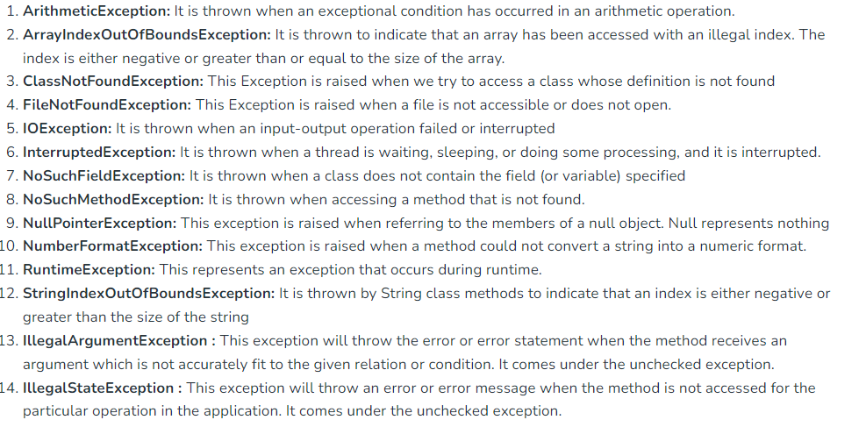

Slide 45
Using Exceptions
Exception handling provides a powerful mechanism for controlling complex programs that have many dynamic run-time characteristics. It is important to think of try, throw, and catch as clean ways to handle errors and unusual boundary conditions in your program's logic. Unlike some other languages in which error return codes are used to indicate failure, Java uses exceptions. Thus, when a method can fail, have it throw an exception. This is a cleaner way to handle failure modes.

Slide 46
Note that Java's exception-handling statements should not be considered a general mechanism for nonlocal branching.
If you do so, it will only confuse your code and make it hard to maintain

